Slide 1
Six Principles
of Graphical Integrity

Slide 2
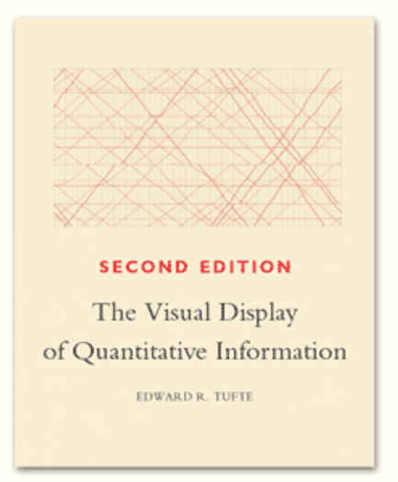
https://www.edwardtufte.com/tufte/books_vdqi

Slide 3
Six Principles of Graphical Integrity:
The first two are (quoted directly from page 56):
1. The representation of numbers, as physically measured on the surface of the graphic itself, should be directly proportional to the numerical quantities measured.
2. Clear, detailed, and thorough labeling should be used to defeat graphical distortion and ambiguity.
Write out explanations of the data on the graphic itself.
Label important events in the data.
Source: http://stat.pugetsound.edu/courses/class13/dataVisualization.pdf

Slide 4
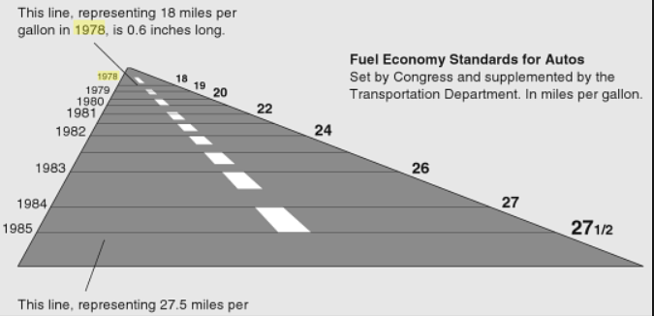
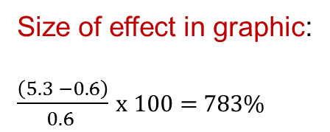
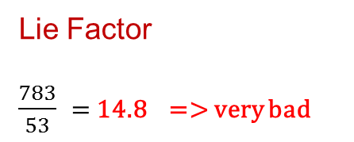
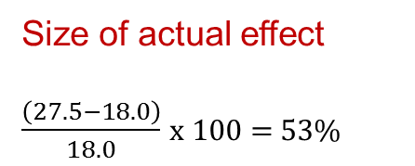
Lie Factor
This line, representing 27.5 miles per gallon is 5.3 inches long
Size of effect in graphic:
$\frac{\left(5.3 −0.6\right)}{0.6 }$ x 100 = 783%
Size of actual effect
$\frac{\left(27.5−18.0\right)}{18.0}$ x 100 = 53%
Lie Factor
$\frac{783}{53}$ = 14.8 => very bad
Source: http://www.learnqlikview.com/wp-content/uploads/2015/08/fuel-economy.png
Original image from New York Times, August 9, 1978, D-2

Slide 5
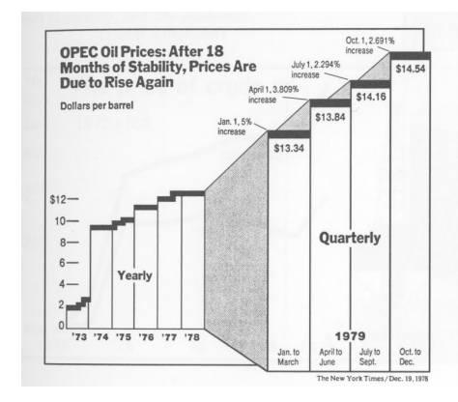
Third Principle of Graphical Integrity (page 61):
Show data variation, not design variation
For example, avoid things like this:
Source: http://stat.pugetsound.edu/courses/class13/dataVisualization.pdf

Slide 6
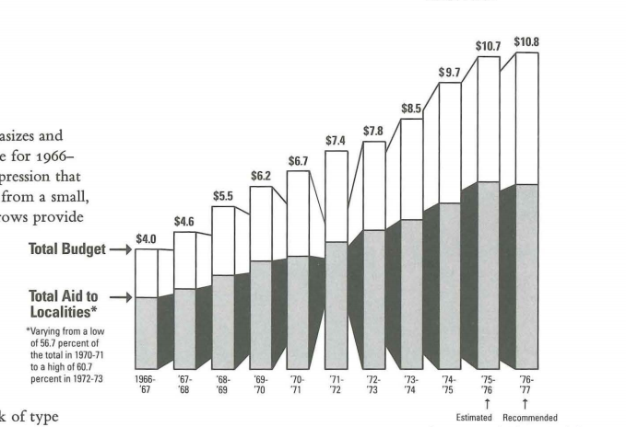
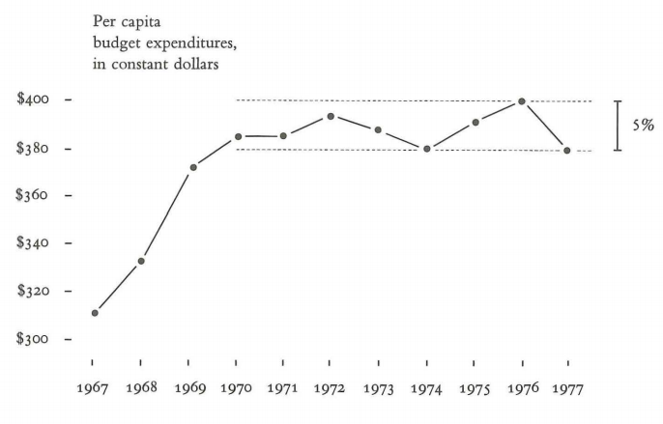
The Fourth Principle of Graphical Integrity (page 68):
In time-series displays of money, deflated and standardized units of monetary measurement are nearly always better than nominal units.
Adjusted for inflation and population growth
Source: https://myelms.umd.edu/courses/1132632/files/37617480/download?verifier=IiOuftNvOV0hWJwaNnVeozdny7JDid0ujnsVGEJA&wrap=1

Slide 7
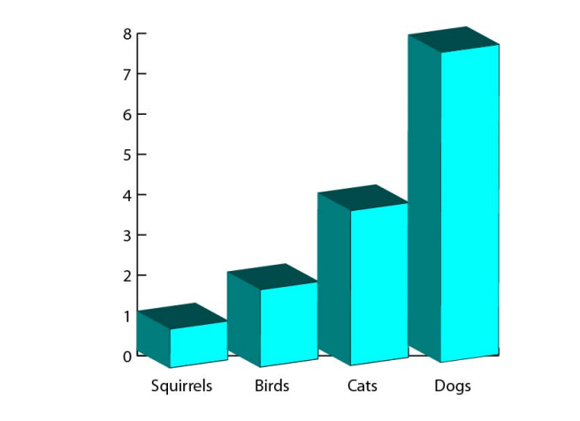
Fifth Principle (page 71):
The number of information-carrying (variable) dimensions depicted should not exceed the number of dimensions in the data
=> Avoid 3d to represent something that only needs to be 2d.
Source: http://stat.pugetsound.edu/courses/class13/dataVisualization.pdf

Slide 8
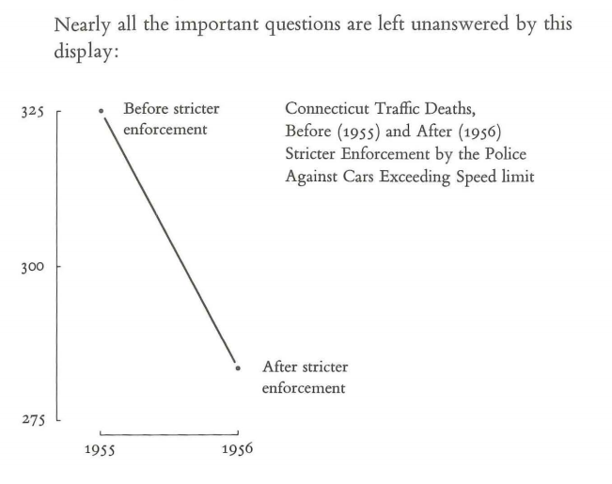
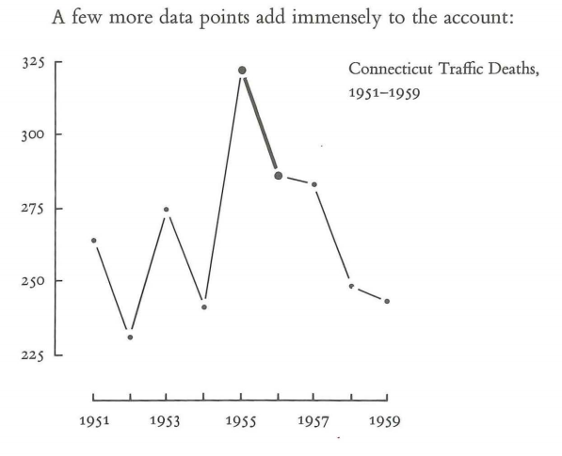
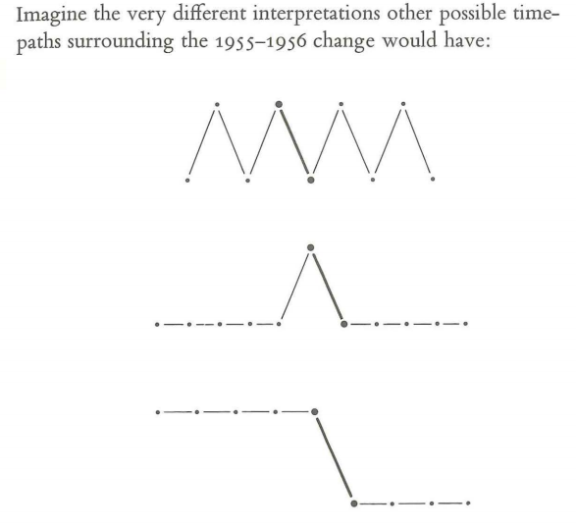
Sixth Principle (Page 74):
Graphics must not quote data out of context
We will examine this one more closely in Week 5
Source: https://myelms.umd.edu/courses/1132632/files/37617480/download?verifier=IiOuftNvOV0hWJwaNnVeozdny7JDid0ujnsVGEJA&wrap=1

